Slide 1
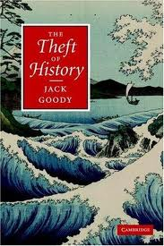

Who stole what?
Time and space
曾瑀婷
張溱雅
林怡璇
李宜霈
林品萱

Slide 2
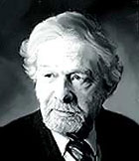
Who is Jack Goody?
Jack Goody (1919-1987)
British social anthropologist.
A pioneer in the comparative anthropology of literacy

Slide 3

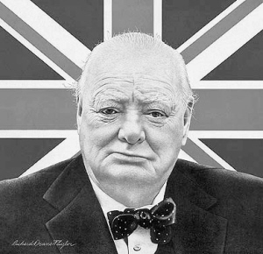
Churchill said, "History is written by victors."

Slide 4

What is history?
What is stolen?
Why Goody writes this article?
Why history is dominated by Europe culture?
How to steal history?
How Goody persuades readers?

Slide 5
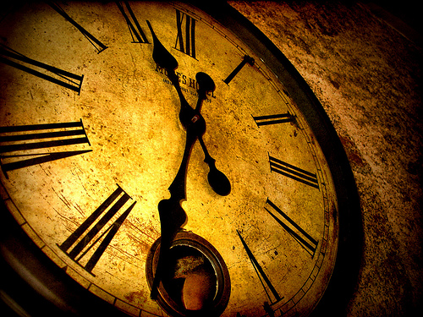
The Theft of Time
Time plays the vital role in the definition of history.
Time is a part of the measuring system used to sequence events, to compare the durations of events and the intervals between them, and to quantify rates of change such as the motions of objects.

Slide 6
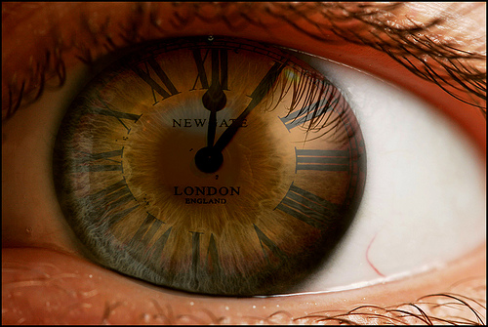
The very calculation of time in the past, and in the present too, has been appropriated by the west.

Slide 7
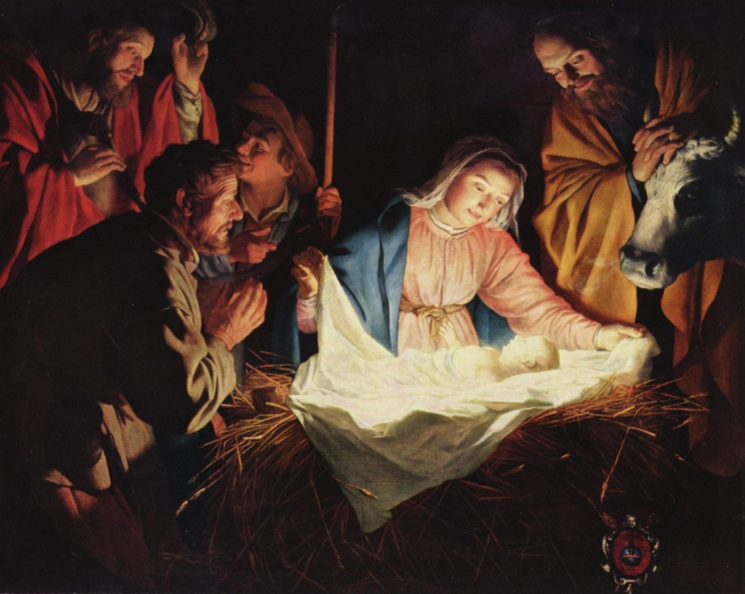
Oral culture: Reckoned according to natural occurrences.
Written culture:
Measured by the record of big events.
e.g. The birth of Christ (BC or AD)
The concept of century and millennium

Slide 8

The monopolization of time:
era, years, months, weeks, and days.
Reasonable: Sidereal year
Logical: Lunar year
Seven days a week
Religious framework of reckoning time
e.g. Christmas, Easter, Halloween

Slide 9

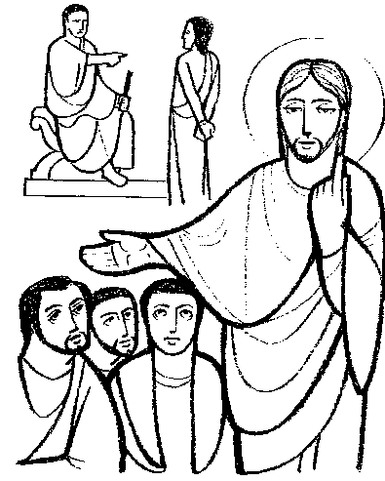
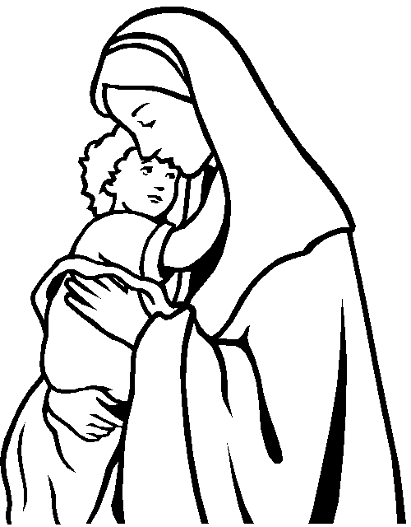
Religion
The religious infiltration
Single dominant religion

Slide 10
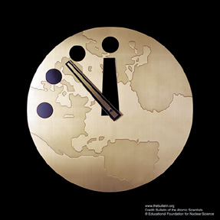
Clock
Unique to literate cultures
The organization of the universe
The popularization of clockwork
→the popularization of capitalism and
factory system

Slide 11
Linear: beginning with the act of creation by God. The general Christian view is that time will end with the end of the world.
Circular: A concept of wheel of time, regards time as cyclical and quantic consisting of repeating ages that happen to every being of the Universe between birth and extinction.

Slide 12
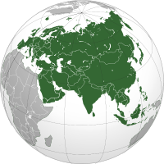
Space
P. 19
→Definition:
the unlimited expanse in which everything is located.
The continents themselves are hardly exclusively western notions, as they offer themselves intuitively to analysis as distinct entities, except for the arbitrary divide between Europe and Asia.
(Geographically, Europe and Asia
form a continuum, .)
Eurasia

Slide 13
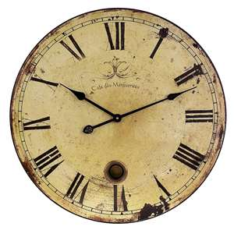
Later ‘world’ religions and their followers, greedy to dominate space as well as time, have even made an attempt officially to define the new Europe in Christian terms, despite its history of contacts with, and indeed, the presence of, followers of Islam and Judaism in that continent, and despite the insistence that contemporary Europeans (in
contrast to others) often give to a
secular, lay attitude to the world.
the clock of years ticks to a Christian tempo.

Slide 14
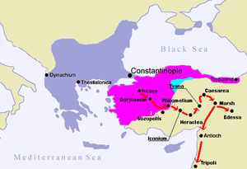
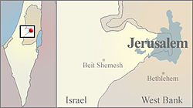

However, conception of space have not been influenced by religion to quit the same extent as time.
From early on Christians were drawn to pilgrimages to Jerusalem and the freedom to make such journeys was one of the reasons behind the European invasion of Near East from the thirteenth century known as the Crusades.
→
Jerusalem
First Crusade 1095–1099

Slide 15
P. 20
The initial religious motivation may disappear, but the internal geography it generates remains, is ‘naturalized’ and may be imposed on others as being somehow part of the material order of things. (Line.7)
But the effects of western colonization are apparent. When Britain became internationally dominant, the co-ordinates of space turned around the Greenwich meridian in London; the West Indies and largely the East Indies were created by European concerns, as well of course as by European orientations, European colonialism, European expansion overseas.

Slide 16
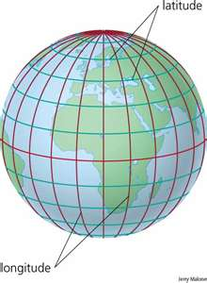
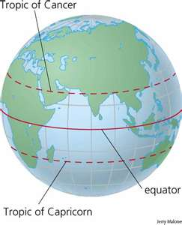
Latitude was defined in relation to the equator. But longitude posed different problems, because there was no fixed starting point.
Latitude
Equator
Longitude

Slide 17
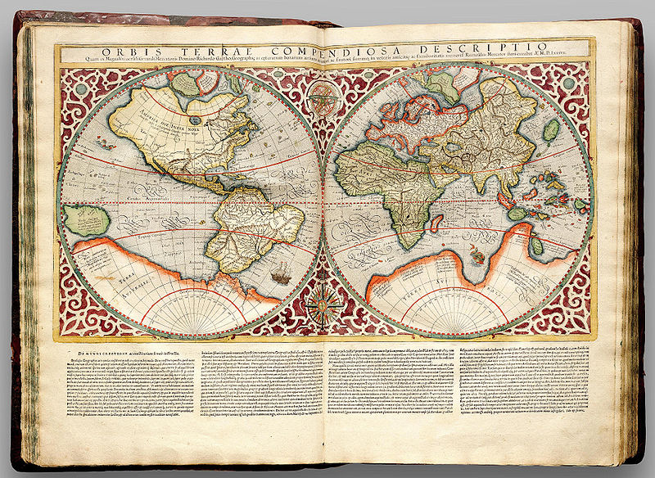
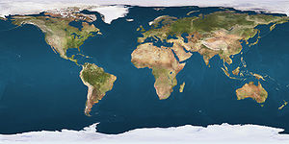
Greenwich meridian
John Harrison (1693-1776)
0°c
Gerardus Mercator in his Atlas Cosmographicae (1595) uses a prime meridian
in the Atlantic, intended to separate the Old World (Eurasia and Africa) and
the New World (the Americas) into two hemispheres.
Mercator's 180th meridian runs along the Strait of Anián (Bering strait),
while his prime meridian corresponds to somewhere close to 25° W,
passing just to the west of Santa Maria Island.

Slide 18
Mercator projection
The ‘distortion of space’ to which I referred occurred because orbs have to be flattened for the printed page, and the projection is an attempt to reconcile the sphere and the plane.
The ‘distortion’ took on a specifically European slant that has dominated modern map-making throughout the world.

Slide 19
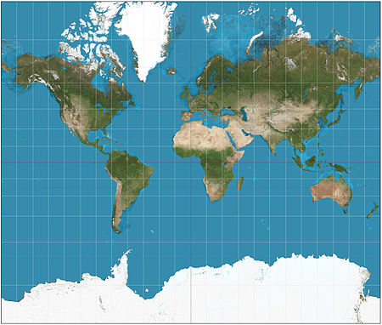
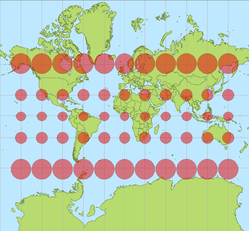
Southern countries like India appear small
in relation to northern ones like Sweden,
whose size is greatly exaggerated. (P.20)

Slide 20
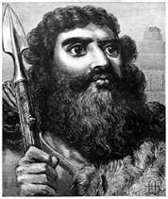
Map-making
Babylonians
Greeks
Arabic-speaking world
Romans
Persia
India
China

Slide 21
A unique line of developement
Feudalism
Renaissance
Reformation
Absolutism
Capitalism
Industrialization
Modernization
Its expansion meant that its notions of time,
developed in the course of the ’Age of
Exploration’, and its notions of time,
developed in the context of Christianity,
were imposed upon the rest of the world.

Slide 22
Periodization
Division into periods: the dividing of history into distinct and identifiable periods.
Most societies seem to make some attempt to categorize their past in terms of different, large-scale, periods of time.

Slide 23
Monopolization
The ‘theft of history’ is not only one of time and space, but of the monopolization of historical periods.
In recent times Europe has appropriated time in a more determined manner and applied it to the rest of the world.

Slide 24
Basically Christian
the international calculus
the major holidays celebrated by world bodies
the oral cultures of the Third World
the major religions.
Modern science

Slide 25
Globalization meant westernization!

Slide 26
Although…
Globalization entails a measure of universality.
One cannot work with purely local concepts.
Problems!…
arise when European concepts
are applied to other times and
to other places.

Slide 27
One major problem
the accumulation of knowledge: the very categories employed are largely European.
Let’s take ‘philosophy’ for example the following!

Slide 28
Written thought
Westerners give attention
e.g. Chinese, Indian, or Arabic thought
Non-literate societies
get less attention
e.g. the Bagre of the LoDagaa of northern Ghana

Slide 29
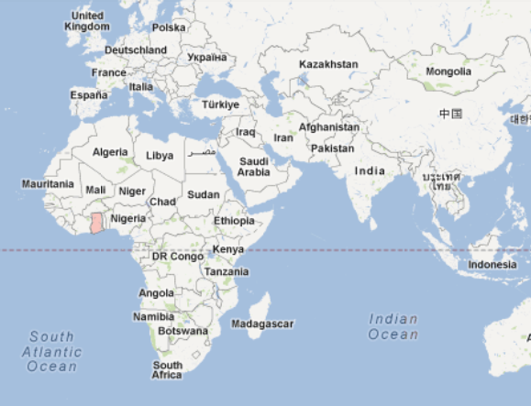
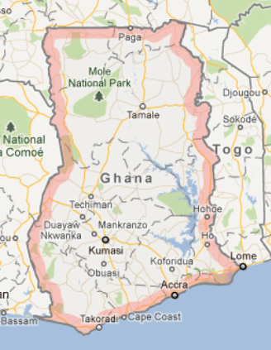
HERE!
Even though…
we find some substantive ‘philosophical’ issues in formal recitations like that of the Bagre!

Slide 30
Simple, pre-literate societies have little knowledge of any ‘progression’ of cultures?

Slide 31
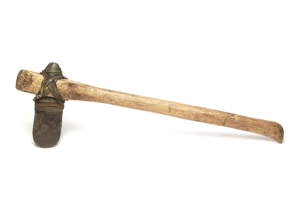
Their cultural myth
God’s axes
Axes sent by the rain god
Iron emerged with the ‘firstmen’

Slide 32
They had no view of long-term change
from a society (using stone tools)
to one (employing iron hoes).
But life moves on in different way
and change did occur.

Slide 33
Colonialism and the
coming of the Europeans
certainly lead them to consider
cultural change and the word ‘progress’ is in current use.

Slide 34
Linearity
advance
progress
The West

Slide 35
Since the Renaissance the speed of change
Written cultures
Two-way progress
looking backward
looking forward to a new beginning
a fixed calendar
the drawing of a line

Slide 36
After the Enlightenment
*the coming of a dominant secularity
*a world ruled by this idea of progression

Slide 37
History?
History is a sequence of stages.
For most historians
the moment of writing:
in the vicinity of the final target of mankind’s development.

Slide 38
Values
What we define as progress is reflective of values.
What values?
*be very specific to our own culture
*be of relatively recent date

Slide 39
The whole of world history has been conceived as a sequence of stages which are predicated upon events that have supposedly taken place only in western Europe.

Slide 40
Conclusion
There is no true history in the world.
Chinese culture > Europe culture
→ what will happen?

